Slide 1
Movie Recommender system Final Project OPIM5894 Data Science with Python
Team: Pybots
- Gaurav Vijay
- Prachi Gupta
- Ravi Srivastava
- Karpagam
- Swati Arora

Slide 2
Contents
Overview
Introduction to Recommender System
Data Description and Exploration
Popularity Based Model
Collaborative Filtering – User Based
Collaborative Filtering – Item Based
Model Evaluation
Content Based Model
Next Steps
Conclusion

Slide 3
Overview
Which digital camera should I buy?
What is the best holiday for me and my family?
Which is the best investment for supporting the education of my children?
Which movie should I rent?
Which web sites will I find interesting?
Which book should I buy for my next vacation?
Which degree and university are the best for my future?

Slide 4
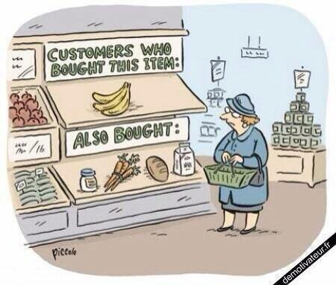
What Is RS?
System that automatically predicts how a user will like an item based on:
Past behavior
Relations to other users
Item similarity
Context

Slide 5

Why RS?
Netflix: 2/3 rented movies are from recommendation
Google News: 38% more click-through are due to recommendation
Amazon: 35% sales are from recommendation
Enhance user experience
Assist users in finding information
Reduce search and navigation time
Increase productivity
Increase credibility
Mutually beneficial proposition

Slide 6
Types of RS
Two broad types:
Content based RS
Recommend items similar to those users preferred in the past
User profiling is the key
Items/content usually denoted by keywords
Matching “user preferences” with “item characteristics” … works for textual information
Vector Space Model widely used
Collaborative RS (User Based and Item Based)
Use other users recommendations (ratings) to judge item’s utility
Key is to find users/user groups whose interests match with the current user
Vector Space model widely used (directions of vectors are user specified ratings)
More users, more ratings: better results

Slide 7
Data Description
The dataset used was from MovieLens Database – For simplicity, we used the dataset with over 1 million ratings from 6040 users on 3883 movies
Users data
Ratings data
Movie data
UserID | Age | Gender | Occupation | Zip code
UserID | MovieID | Rating | Timestamp
MovieID | Title (Year) | Genres

Slide 8
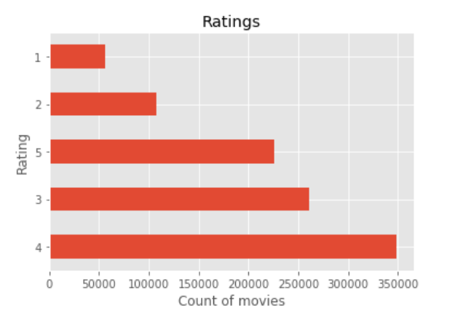
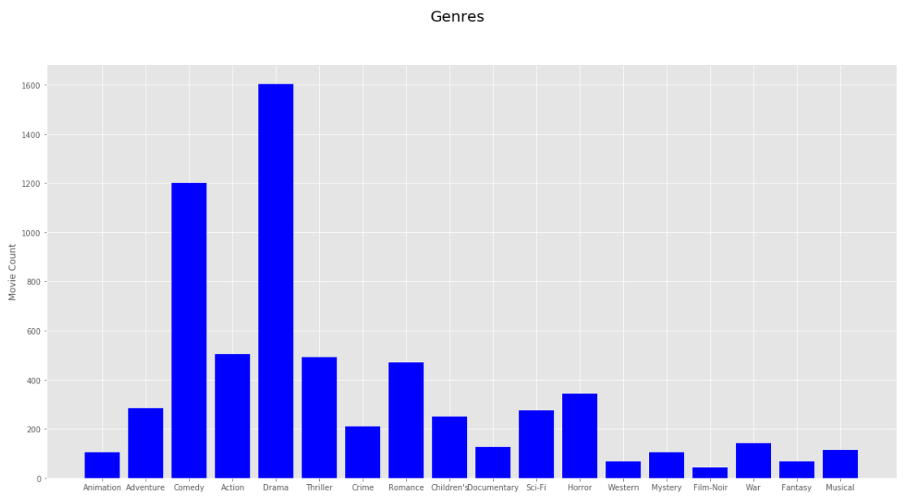
Data Exploration
Users have rated movies from 1-5 There are a total of 18 Genres for 3883 Movies

Slide 9
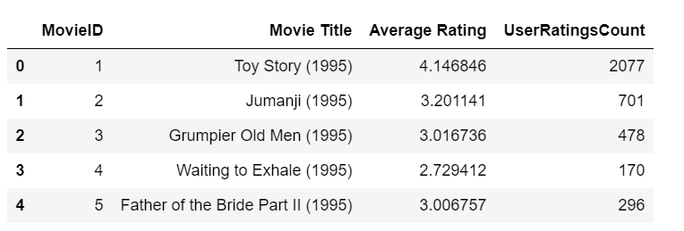
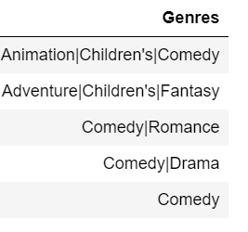
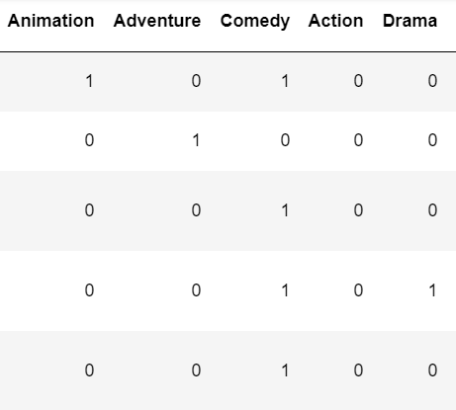
Data Preprocessing
There are over 1 million user ratings given by 6040 users for 3706 movies (Total- 3883 movies)
There were more than one genre for many movies in the database and we split the data to populate a new genre data frame which contains 18 movie genre columns for all the movies (1 if the movie belongs to that genre, else 0)

Slide 10
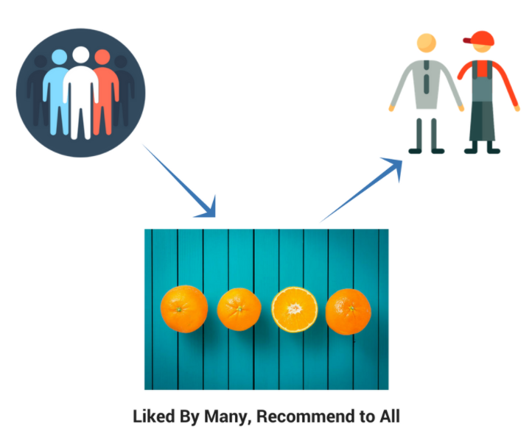
Popularity Based
Popularity based approach works by recommending the movies which are liked by most number of users
By calculating the count of users who rated the movie and then sorting the user count based on Movie ID, we derived the most popular movies to be recommended
popular = df.groupby('MovieID')['Rating’ ].count()
most_popular =pd.DataFrame(popular.sort_values(ascending=False))
Limitations: No personalized Recommendations

Slide 11
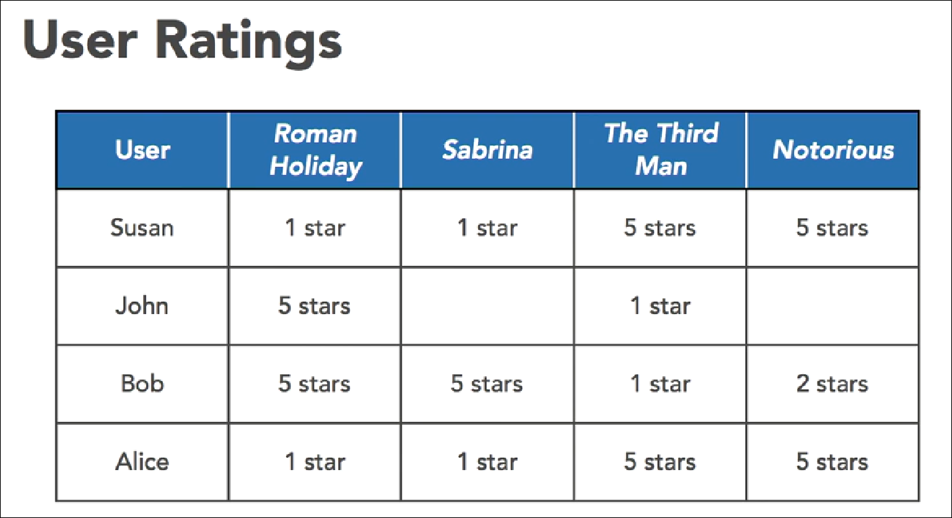
Collaborative Filtering : User Based
Use other users recommendations (ratings) to judge item’s utility
Key is to find users/user groups whose interests match with the current user
Advantage: Don’t require any knowledge about the product themselves
More users, more ratings: better results
Notes:
If we want to recommend a movie to user X – we will find the group of similar users as X (neighbourhood of user X)
We will find other movies liked by the set of users and recommend the movies to X.

Slide 12
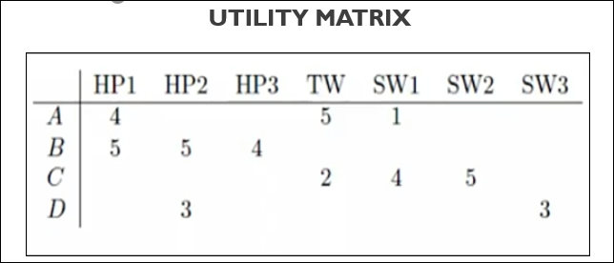
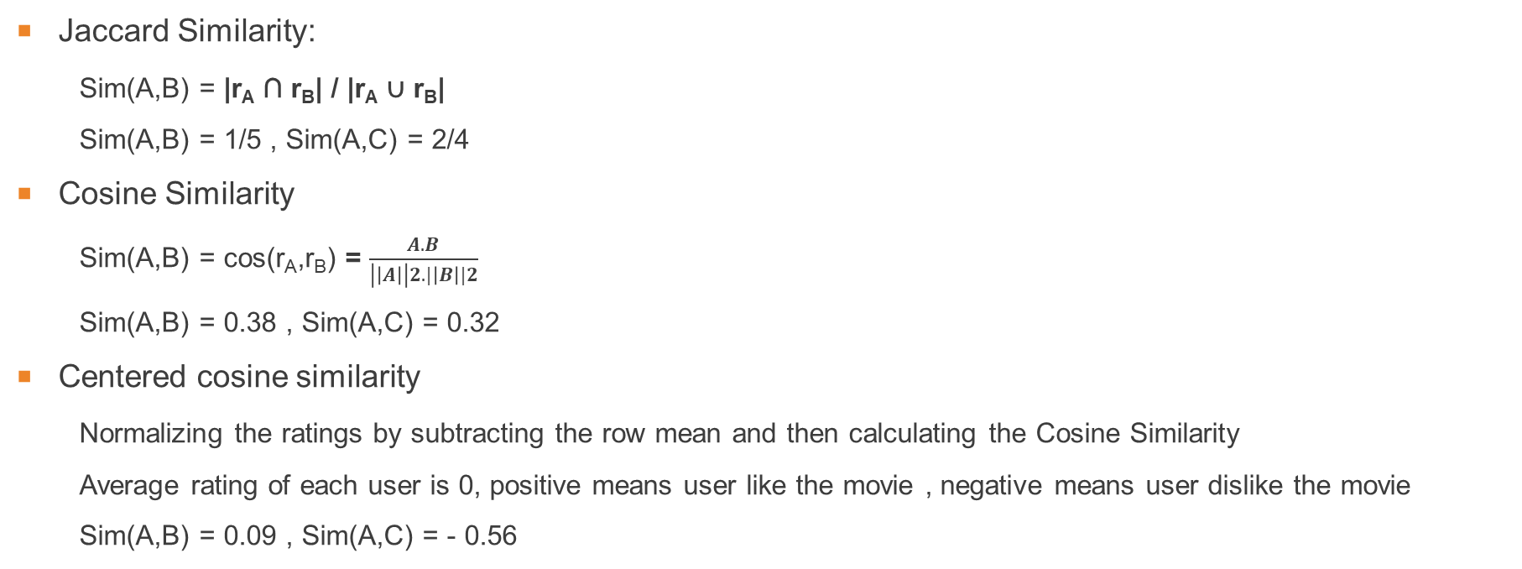
Similarity Matrix
Jaccard Similarity:
Sim(A,B) = |r_{A} ∩ r_{B}| / |r_{A} ∪ r_{B}|
Sim(A,B) = 1/5 , Sim(A,C) = 2/4
Cosine Similarity
Sim(A,B) = cos(r_{A},r_{B}) = $\frac{A.B}{\left|\left|A\right|\right|2. |\left|B\right||2}$
Sim(A,B) = 0.38 , Sim(A,C) = 0.32
Centered cosine similarity
Normalizing the ratings by subtracting the row mean and then calculating the Cosine Similarity
Average rating of each user is 0, positive means user like the movie , negative means user dislike the movie
Sim(A,B) = 0.09 , Sim(A,C) = - 0.56
Notes:
Similarity matrix between users…
Jaccard similarity – it ignores the rating value …hence not used in this scenario
cosine similarity – cos of the angle between A and B.. Problem is it treat missing rating as negative
Centered cosine similarity: normalizing ratings by subtracting the row means/ avg rating of user
Cos(A,B)

Slide 13
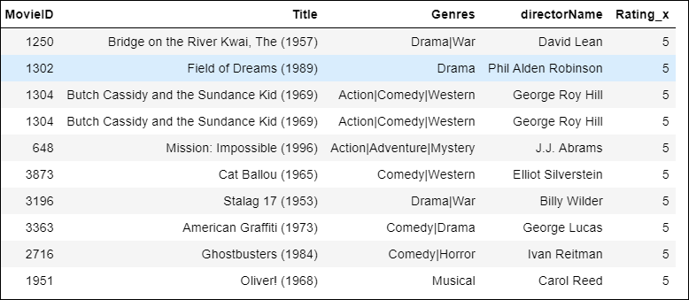
Collaborative Filtering : User Based Algorithm
Read Ratings Dataset
Create Utility Matrix for data with User ID as rows and Movie ID as columns with each row containing the rating
Normalize the resulting matrix
Replace null values with 0
Calculate Cosine Similarity and sort the values in descending order to find similar Users
Take the top 10 users and the movies they watched
Recommend the best rated movies by the Users Similar to User A

Slide 14
Collaborative Filtering :Item Based
Major Problems With User Based:
Scalability: The computation increases as the number of users increases. User-based methods work fine for thousands of users, but scalability gets to be a problem when we have a million users.
Sparsity: Most recommendation systems have many users and many products but the average user rates a small fraction of the total products.
Item-based filtering:
Identifies products that are most similar to each other.
Combines that with a user's rating of items to generate a recommendation
No Need to Store all ratings.

Slide 15
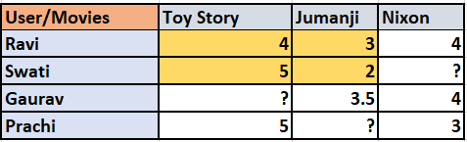
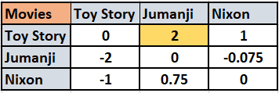

Weighted Slope One Algorithm for Item based : Deviation Matrix
User Ratings Matrix
Deviation Matrix
Dev(Toy Story, Jumanji): An Average User Rated Toy Story 2 Times Better Than Jumanji

Slide 16

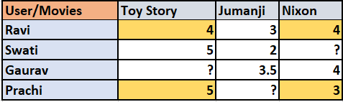
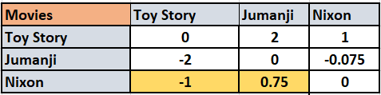
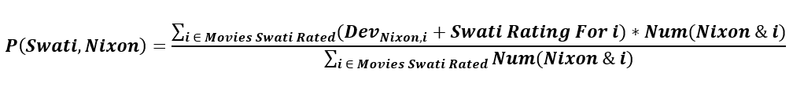
Weighted Slope One Algorithm for Item Based Predictions
User Rating Table
Movie Deviation Matrix
P(Swati, Nixon): 3.375

Slide 17
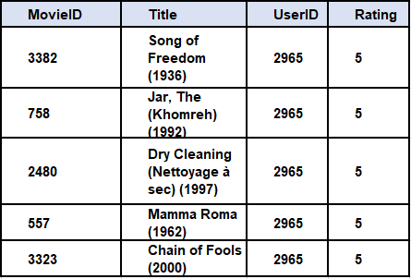
Evaluation
Divided the Data into Training (900K Rows) & Test (100K Rows).
Trained our Model to create a Deviation Matrix using Slope one.
Made Predictions on Test set.
Calculated RMSE and MAE by comparing the actual rating and
predicted rating.
RMSE: 0.002
MAE: 0.71
Recommended Top 5 Movies which user has not Watched Before
Top 5 Movies Recommended to User 2965

Slide 18
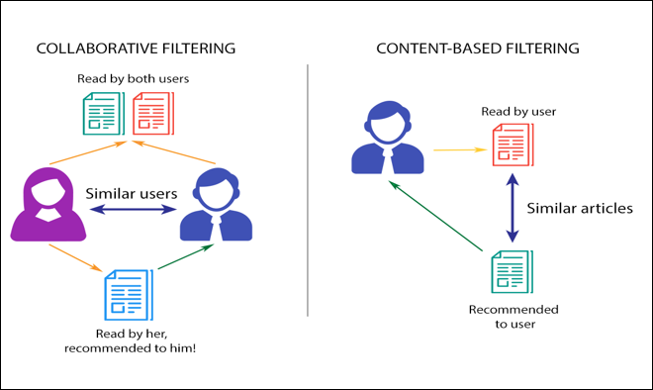
Content Based Filtering : How it is Different?
solves this problem as
Item Cold Start Problem
Collaborative method - New item will not be recommended.

Slide 19
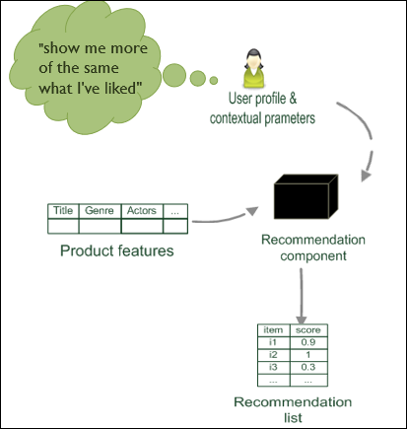
Content Based Filtering Recommendation
Content Filtering
Assumed each user is independent
recommend fantasy novels to people who liked fantasy novels in the past
What do we need:
Item information – genre, star cast
User profile – preferences, rating, past purchase behavior
The task:
Learn user preferences
Identify and recommend items "similar" to user preferences

Slide 20
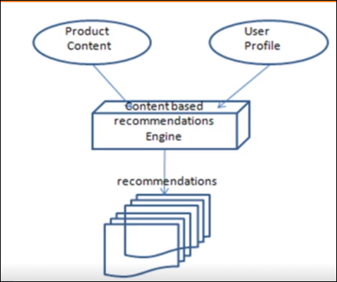
Content Based Algorithm : Step 1- Profile Generation
Structured Data – Obtained from database
Unstructured Data – reviews, tags or textual properties
Tf-Idf can be used for relative feature importance
Content of the model is generated in the vector space model

Slide 21
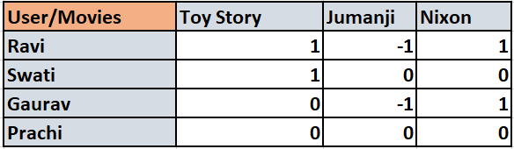
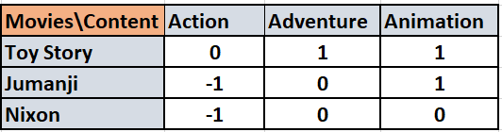
Content Based Algorithm : Step 2- User Profile Generation
Rating Matrix = (# of users) * (# of movies)
Item Matrix = (# of movies) * (# of features)
User Profile = Item Matrix (dot multiply) Rating Matrix
Output = (# of user) * (# of features)

Slide 22
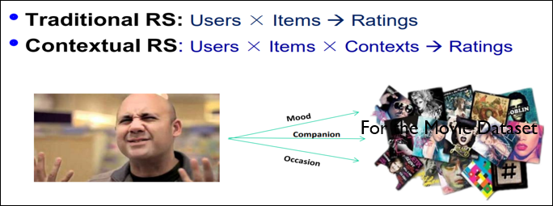
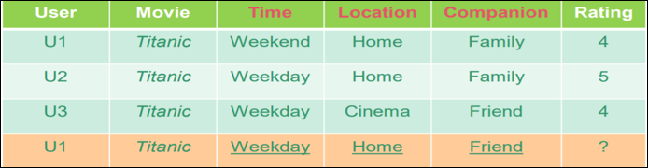
Next Steps : Context Based Recommendation
Context – present state of the user
Physical Context – Time , Place , Day
Social Context – Presence and role of other people around the user
Media Context – Device used to access the system Modal Context – Mood, Goal , Experience

Slide 23
Solving the Research Problem
Long Tail Problem
A small set of popular items out of a much larger set get recommended and others are left out
This was based on needs in brick and mortar stores where space was limited
Solution to long tail
In online world, where space is no constraint, we should look at less popular items and match
them with users based on preferences

Slide 24
Thank You!!

